Slide 1

Chemicals in Cosmetics
Qasim Malalla | Ebrahim Khalil | Talal Aljowder
Notes:
Good afternoon, everyone.Let me begin with something simple: How many of you used a cosmetic product today?Toothpaste. Shampoo. Deodorant. Moisturizer. Maybe a bit of cologne or makeup. Most of us did — often without even thinking about it. It’s just part of the routine, right?Now here’s the real question: Do you know what’s in those products?Probably not. We assume — we trust — that someone, somewhere, has made sure they’re safe.But is that trust well placed?Today, we’re diving into the data behind chemicals in cosmetics. Not just what’s in the products — but how it’s being tracked, updated, and regulated. Because this isn’t just a chemistry problem. It’s a transparency problem. A public health concern. A policy gap.I’m Qasim Malalla, and along with my colleagues Ebrahim Khalil and Talal Aljowder, we’ve analyzed tens of thousands of product records to uncover what’s really going on behind the.
Let’s begin with a single, pressing question.

Slide 2
Are chemical ingredients in cosmetics being tracked, updated, and removed responsibly?
Identify which types of cosmetic products contain the most reported chemicals
Detect if chemicals are still being reported after products or ingredients are discontinued
Assess how actively companies update their chemical records over time
Evaluate the completeness and clarity of chemical reporting in cosmetics
Notes:
Are chemical ingredients in cosmetics being tracked, updated, and removed responsibly?]This question is our anchor today. It might sound basic, but it’s surprisingly hard to answer.Are chemical ingredients being tracked responsibly? Who’s watching? How often? Based on what standards?Are they being updated responsibly? When a new study links an ingredient to harm — is it promptly reviewed, flagged, reformulated?And most importantly — are they being removed when necessary? Because it’s not enough to acknowledge a risk. The industry has to act on it.You see, cosmetic products aren’t regulated as strictly as drugs. In many places, companies aren’t even required to prove safety before going to market. So it becomes even more critical that we understand how well they’re doing when it comes to self-regulation, transparency, and long-term monitoring.Because behind every bottle or jar is a formulation — a chemical cocktail — and consumers are being exposed to hundreds of these compounds, often daily.Our goal with this study was simple: Let the data speak. Show how the industry is actually performing — not how it claims to.

Slide 3
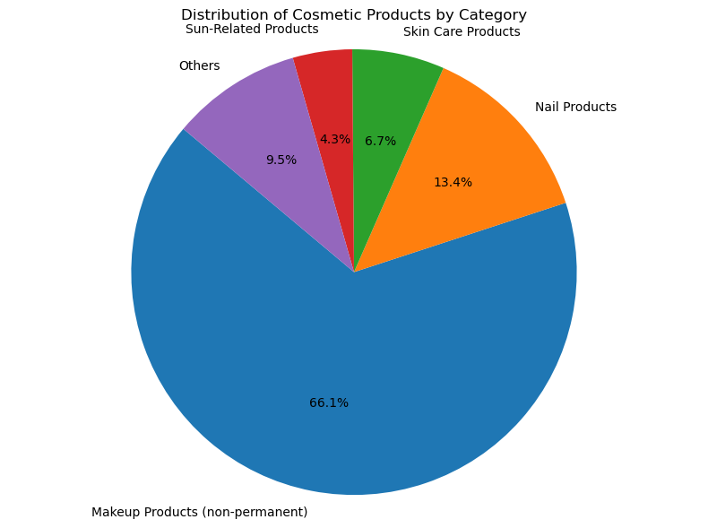
What Kinds of Products Dominate?
114,000+ cosmetic product records analyzed
Products span a wide range of categories (e.g., Skin Care, Hair Care)
Majority of reports come from a few dominant categories
Some products contain 20+ reported chemicals
Complexity and transparency vary widely by product
Notes:
et’s start with scale.We analyzed over 114,000 cosmetic product records. That’s a massive database. The products span everything — skincare, hair care, fragrances, oral hygiene — you name it.And here’s what we found: While the product landscape is diverse, just a few dominant categories account for the majority of reported chemical activity.That’s key.Because it tells us where the chemical footprint is most intense — and where consumer exposure is highest.Some products — particularly multi-function ones like anti-aging creams or long-lasting makeup — contain 20 or more chemical ingredients. Many of them are unpronounceable, poorly understood, or under-researched in the context of long-term use.And what’s more, transparency varies wildly. Some brands are clear and detailed about what they use. Others? Not so much.This inconsistency means that the average consumer doesn’t really stand a chance. Unless they’re a chemist with hours to kill cross-referencing databases, they’re relying on companies to be honest and regulators to be vigilant.And that’s where things start to get complicated.

Slide 4
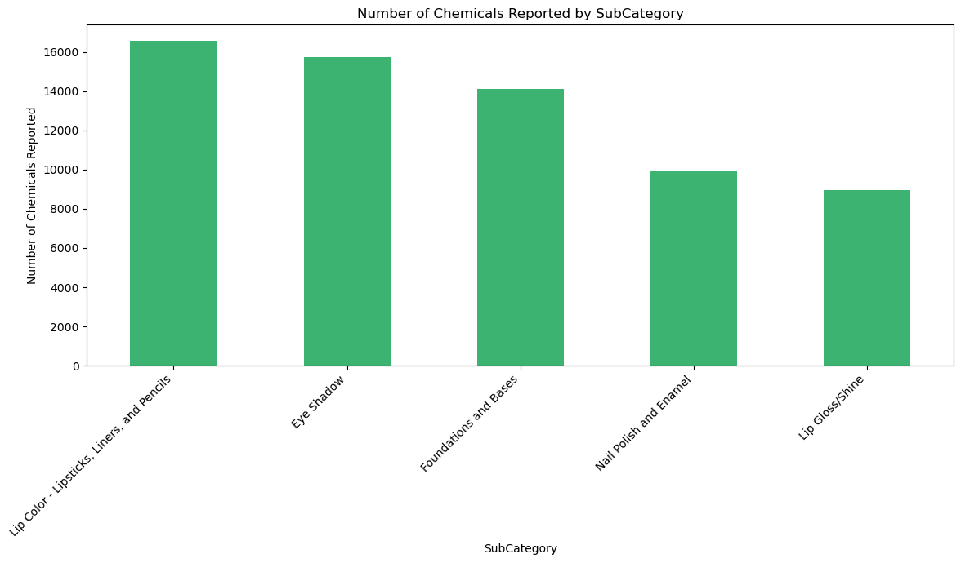
Subcategories with Most Chemicals Reported
These subcategories have the richest chemical profiles, indicating complex formulations.
Prioritizing these areas can improve consumer protection and product innovation.
Highlights industry trends and product development focus.
Notes:
When we broke the data down further — we looked at subcategories.These are the smaller groupings within the broader categories — things like “hair dye,” “face serums,” “nail treatments.”And some of these subcategories? They have incredibly rich chemical profiles — meaning they include a high number and diversity of ingredients. Some are necessary for product function. Others are just… fillers. Or worse, linked to irritation or hormonal disruption.Why does this matter?Because these subcategories are industry trendsetters. They’re where companies are pouring R&D resources. Where marketing is focused. And where consumers are most vulnerable to high-exposure formulas.So, by prioritizing these subcategories — improving how ingredients are tracked and evaluated in just these areas — we could potentially protect millions of consumers more efficiently.But are companies doing that? Are regulators focusing on the right places?

Slide 5
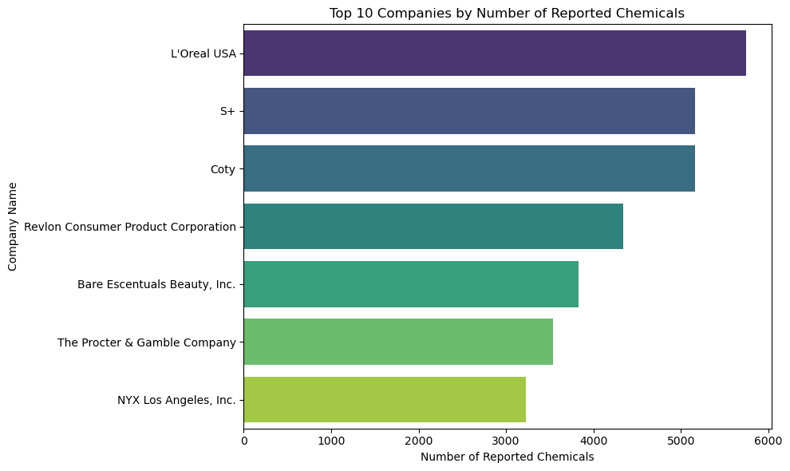
Which Companies Are Behind the Most Reported Products?
Small number of companies are responsible for a large portion of reported products.
These companies are likely market leaders or bulk producers.
It’s important to ensure these high-volume players follow consistent reporting practices.

Slide 6
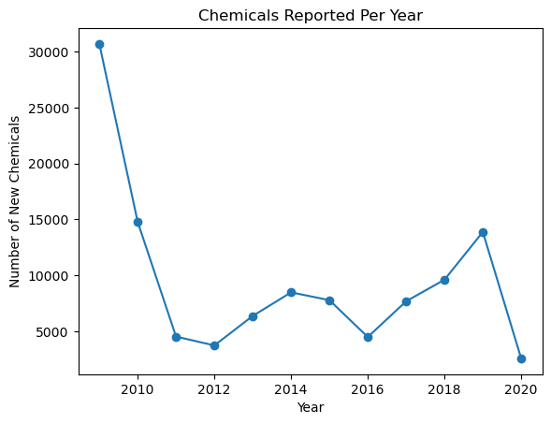
How Has Chemical Reporting Changed Over Time?
Annual reporting patterns reveal industry behavior over time.
Fluctuations may reflect regulatory shifts, public scrutiny, or evolving product lines.
Sudden spikes could indicate regulatory updates or large product rollouts.

Slide 7
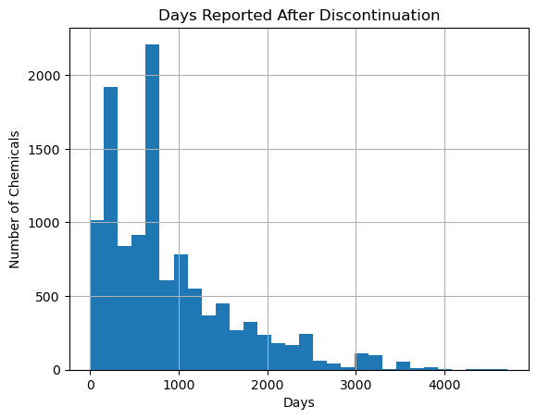
Reporting After Discontinuation
Products are expected to stop reporting chemicals once discontinued.
This suggests delays or inconsistencies in updating product status.
Raises concerns about data accuracy and regulatory follow-through.

Slide 8
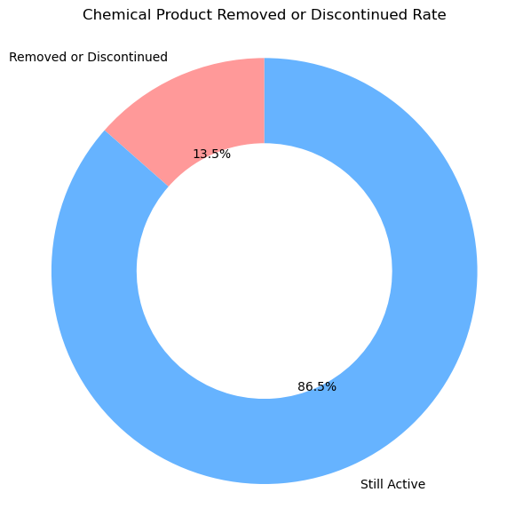
Are Chemicals Removed or discontinued?
86.5% of products neither discontinued nor had chemicals removed
Remaining 12.5% split between discontinued products, removed chemicals, or both

Slide 9
Key Takeaways on Chemicals in Cosmetics
Cosmetic products contain diverse chemicals, with some subcategories having significantly more complex formulations.
Chemical data updates occur, but timing varies — timely updates are crucial for safety and transparency.
Most products remain active with their chemicals unchanged, highlighting the importance of ongoing monitoring.

Slide 10
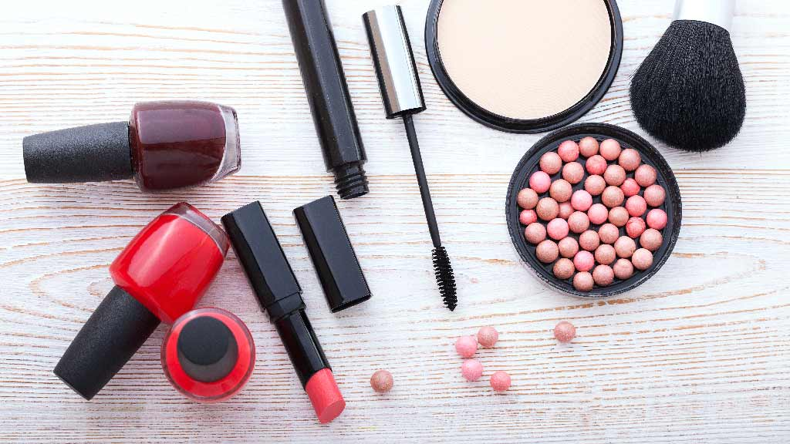
Thank You

